Slide 1


Eric Tang
November 13, 2024

Slide 2

Outline
Executive Summary
Introduction
Methodology
Results
Conclusion
Appendix

Slide 3
Executive Summary
Methodologies
We use the SpaceX API to extract information about their rocket launch missions
Based on data acquired via JSON and SQL requests, we visualize success rate trends and create a prediction model
We use Folium and Plotly to visualize launch sites and success rates with respect to each site and payload size
Results Summary
We have created a model to predict the success rate of a Falcon 9 mission based on many input parameters with 83% test accuracy
We have found that the KSC LC-39A launch site has the highest succewss rate (76.9%), but has no success with payloads over 5500 kg
The FT booster version has highest success rate, while the v1.1 booster has the lowest

Slide 4
Introduction
The first stage of rocket launches is extremely costly. Landing of the first stage is important for saving future costs as the rocket can be reused for later launches.
We are interested in determining which factors can be used to predict whether or not the first stage will land as well as identify important variables related to success rate in order to better understand what conditions will need to a successful landing.

Slide 5

Section 1

Slide 6
Methodology
Executive Summary
Data collection methodology:
The data was collected via JSON and HTML requests from the SpaceX API and Wikipedia
Perform data wrangling
The data was processed using pandas dataframes for ease of use
Perform exploratory data analysis (EDA) using visualization and SQL
Perform interactive visual analytics using Folium and Plotly Dash
Perform predictive analysis using classification models
We created multiple regression models and evaluated their performance on training and test data

Slide 7
Data Collection
The data was collected via JSON and HTML requests from the SpaceX API and Wikipedia
SpaceX API
Decode response (.json()) and normalize the response using pandas
Preprocess data and store in pandas dataframe
Filter Falcon 9 rocket launches
JSON Request
Wikipedia
Falcon 9 Launch Records
Parse HTML tables
Preprocess data and store in pandas dataframe
HTTP GET Request

Slide 8
Data Collection – SpaceX API
GitHub URL
SpaceX API
Decode response (.json()) and normalize the response using pandas
Preprocess data and store in pandas dataframe
Filter Falcon 9 rocket launches
JSON Request

Slide 9
Data Collection - Scraping
GitHub URL
Wikipedia
Falcon 9 Launch Records
Parse HTML tables
Preprocess data and store in pandas dataframe
HTTP GET Request

Slide 10
Data Wrangling
In order to build a predictive model, we convert landing outcomes to binary results with either success or failure and add these values as a new ‘Class’ column in our dataset
GitHub URL
Import CSV data generated in data collection step (Falcon 9 launches)
Convert landing outcomes to binary success (1) or failure (0)
Add binary outcome ‘Class’ to pandas dataframe
Export as CSV

Slide 11
EDA with Data Visualization
We looked at the relationship between flight number and launch site with respect to success. This showed that the KSC LC 39A had the highest success rate.
Next we looked at payload vs. launch site, which showed high success at CCAFS SLC 40 for higher payloads (> 12000 kg) and high success at VAFB SLC 4E for lower payload (< 10000 kg)
We plotted the average success rate for each orbit type and number of flights per orbit type to determine which orbit type is best
We also looked in payload vs. orbit to determine which orbit is best for different payload sizes
GitHub URL

Slide 12
EDA with SQL
Read SpaceX CSV data in pandas dataframe
Convert dataframe to SQL database
SQL: Display unique launch sites and total payload mass carried by CRS boosters
SQL: Display average payload mass carried by booster version F9 v1.1
SQL: Find the first successful ground pad landing date
SQL: List boosters with successful drone ship landings with payloads between 4000 and 6000 kg
SQL: List the total number of successful and failure mission outcomes
SQL: Find the booster version used for the maximum payload launch
SQL: List drone ship landing failures in 2015
SQL: Count the number of landing outcomes between 2010-06-04 and 2017-03-20
GitHub URL

Slide 13
Build an Interactive Map with Folium
Mark all launch sites on the map to see whether geographical factor affect launch site locations
Create marker clusters for each launch site to show success and failures
Calculate the distance between a launch site and the coastline/highway to understand more about launch site location
GitHub URL

Slide 14
Build a Dashboard with Plotly Dash
We created a pie chart to show the distribution of launch successes for each site
We also added a scatterplot and slider for payload range in order to see how payload and booster version affects launch success for each site
GitHub URL

Slide 15
Predictive Analysis (Classification)
We extract Falcon 9 launch data by reading a CSV file into a pandas dataframe
For our target variable, we extract the launch outcome ‘Class’ variable and split data into training and test sets
We explore a number of models and train each to see which model generates the best results for predicting launch outcome
GitHub URL
Convert CSV data to pandas dataframe and extract ‘Class’ information for modeling
Preprocess and split data in training and test sets
Fit models (LogReg, SVM, Decision Tree, KNN) and assess performance
Import CSV data generated in data collection step (Falcon 9 launches)

Slide 16
Results
Exploratory data analysis results
Interactive analytics demo in screenshots
Predictive analysis results

Slide 17

Section 2

Slide 18
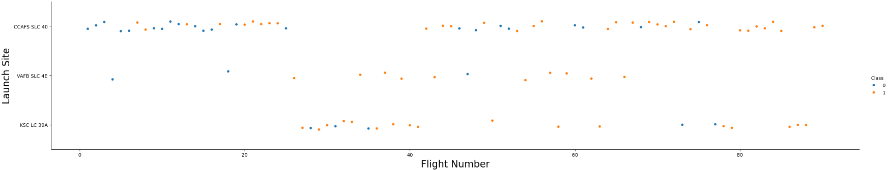
Flight Number vs. Launch Site
Here we can see most of the flights occur at CCAFS SLC 40 launch site
Fewer flights occur at VAFB SLC 4E, but they have a high success rate

Slide 19
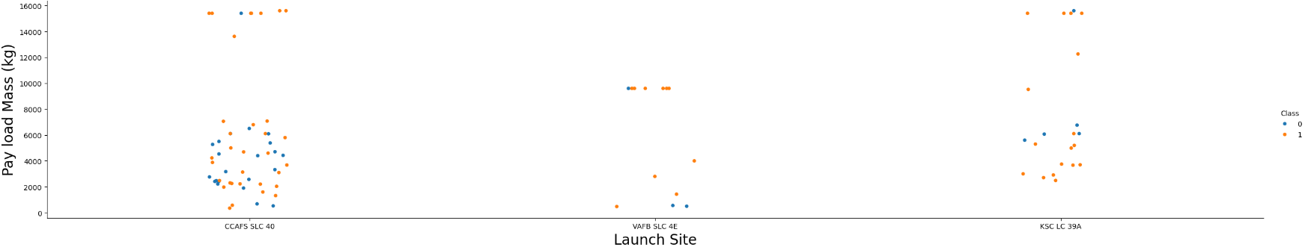
Payload vs. Launch Site
At CCAFS SLC 40, there is a high success rate for payloads > 12000 kg
At VAFB SLC 4E, there is a high success rate for 10000 kg payloads
At KSC LC 39A, there is a relatively high success rate regardless of payload mass

Slide 20
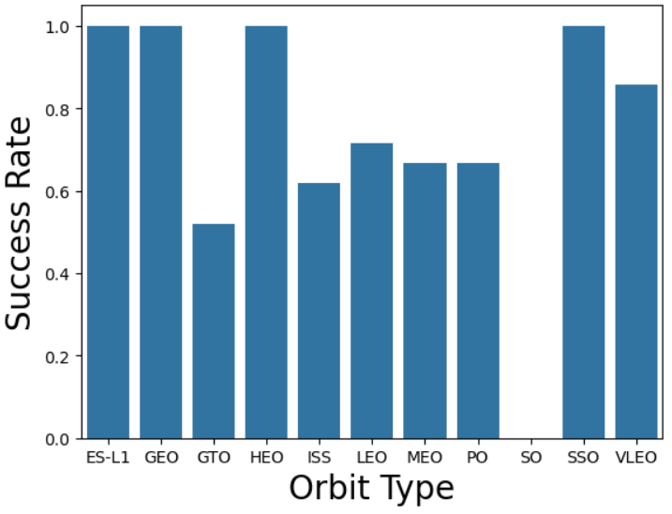
Success Rate vs. Orbit Type
We can see that the SO orbit type has the lowest success rate, whereas ES-L1, GEO, HEO, and SSO all have high success rates

Slide 21
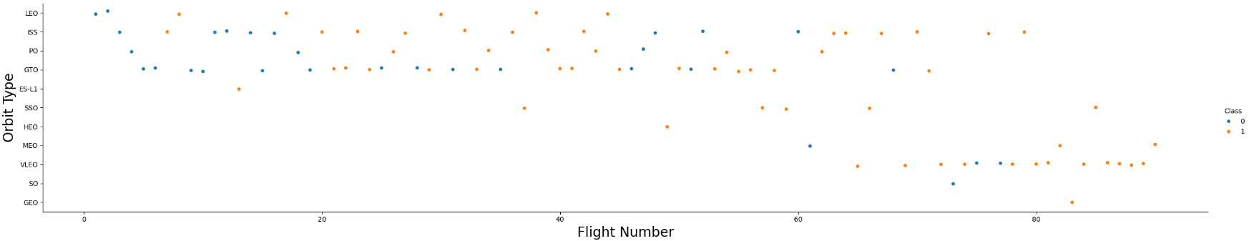
Flight Number vs. Orbit Type
We can see that the ES-L1, GEO, HEO, and SSO orbit types despite having high success rate each have very few number of flights

Slide 22
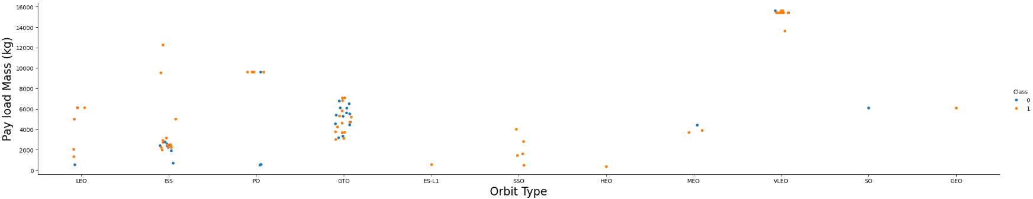
Payload vs. Orbit Type
We can see that for high payloads > 12000 kg, a VLEO orbit has a high success rate
For low payloads < 6000 kg, an SSO orbit has a high success rate
For intermediate payloads of 10000 kg, a PO orbit has a high success rate

Slide 23
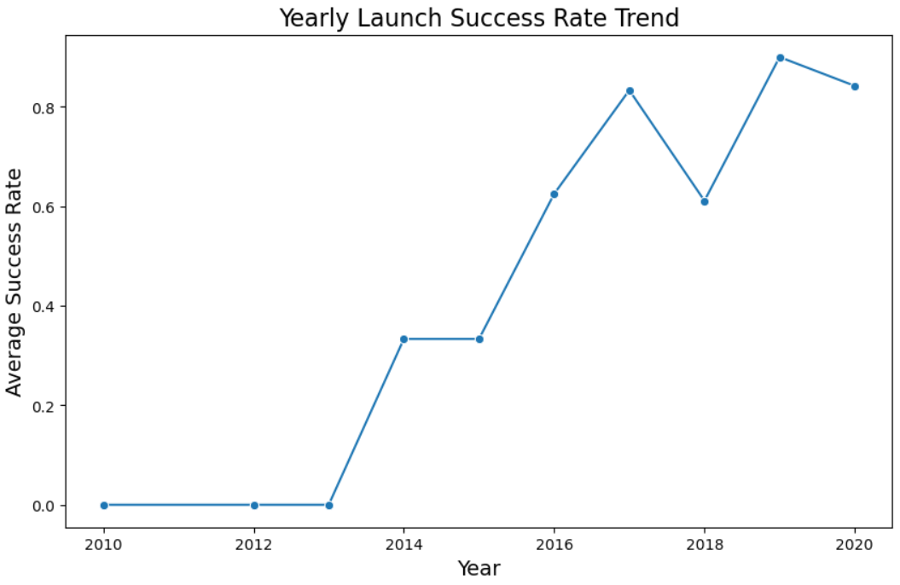
Launch Success Yearly Trend
We can see that initially launches were unsuccessful, but have started to become more successful as time goes on
This makes sense due to having more launch data and more technological development

Slide 24
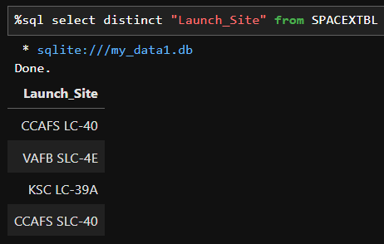
All Launch Site Names
We query the unique launch sites from the database

Slide 25
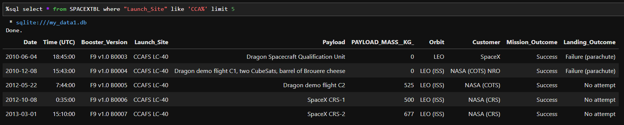
Launch Site Names Begin with 'CCA'
We can search for the ‘CCA’ substring to find 5 records

Slide 26
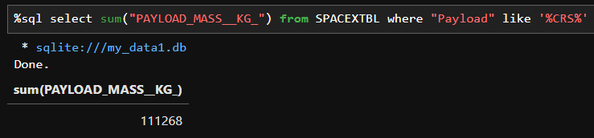
Total Payload Mass
We can sum the payload mass for all boosters from CRS by using a substring search

Slide 27
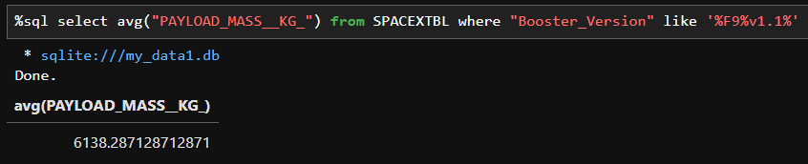
Average Payload Mass by F9 v1.1
By searching for the F9 v1.1 substring, we can find and average all corresponding payload masses

Slide 28
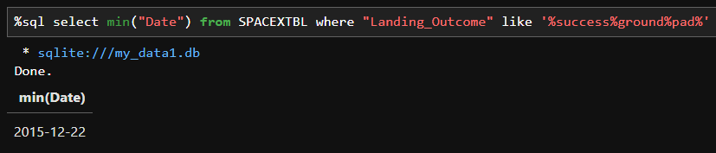
First Successful Ground Landing Date
We can use the minimum function to find the least recent date for a successful ground pad landing

Slide 29
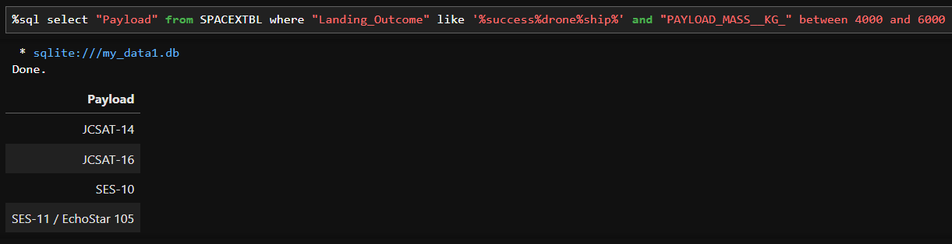
Successful Drone Ship Landing with Payload between 4000 and 6000
We can use two conditions to search for successful drone ship landings and payload masses between 4000 and 6000 kg

Slide 30
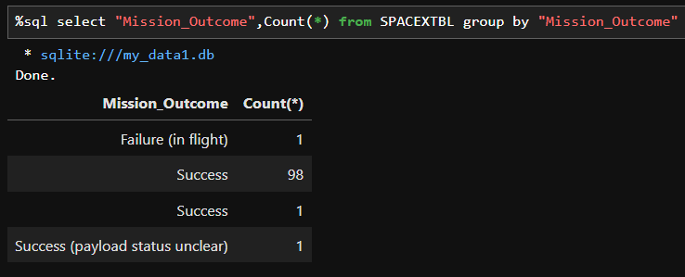
Total Number of Successful and Failure Mission Outcomes
We can use the COUNT function to count the number of success or failure missions by group data by the mission outcome

Slide 31
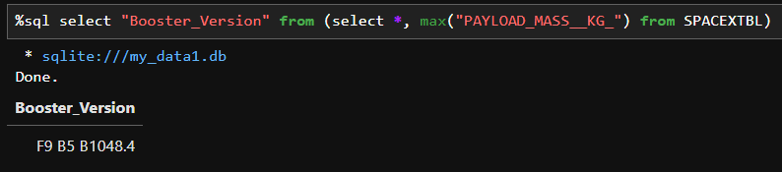
Boosters Carried Maximum Payload
By using a subquery, we can isolate the data that has the maximum payload from the database and then select the booster version

Slide 32
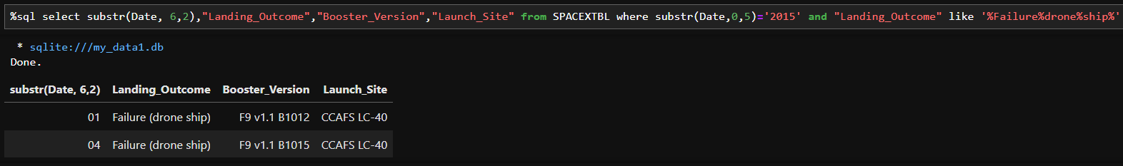
2015 Launch Records
Here, we can list information by searching for launches in the year 2015 whose outcome was a drone ship landing failure

Slide 33
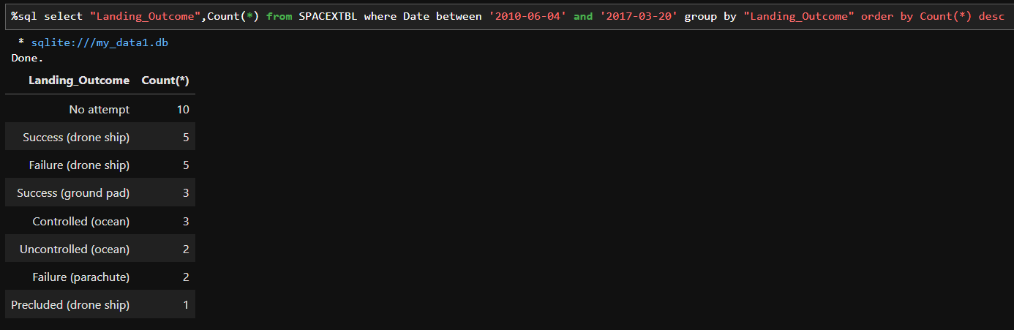
Rank Landing Outcomes Between 2010-06-04 and 2017-03-20
Here we can identify and count the number of each outcome by group the data by landing outcome and filtering results between 2010-06-04 and 2017-03-20 in descending order

Slide 34

Section 3

Slide 35
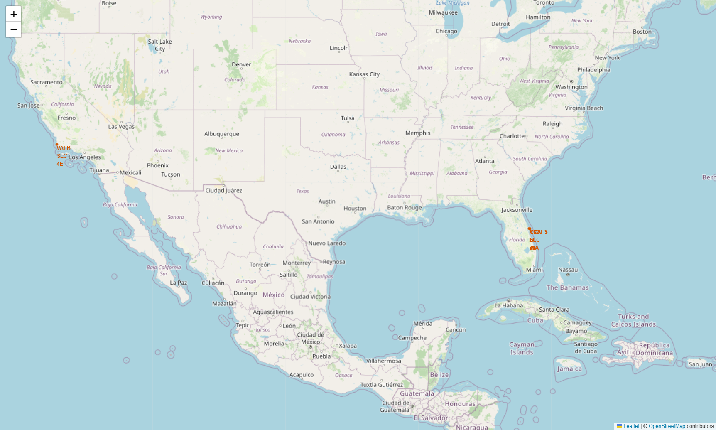
Folium: Launch Site Locations
Here, we can see launch sites are located extremely close to the coastline

Slide 36
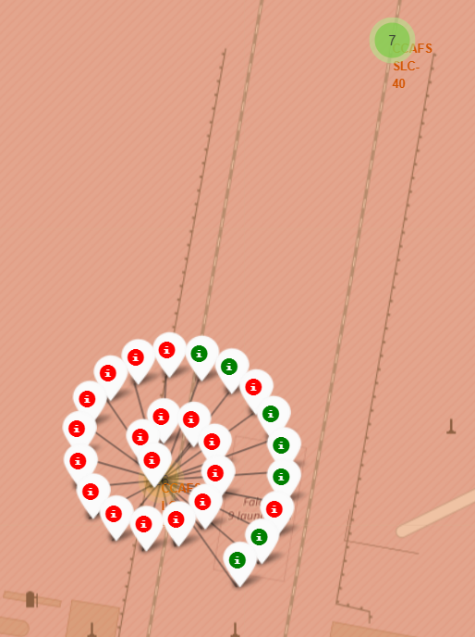
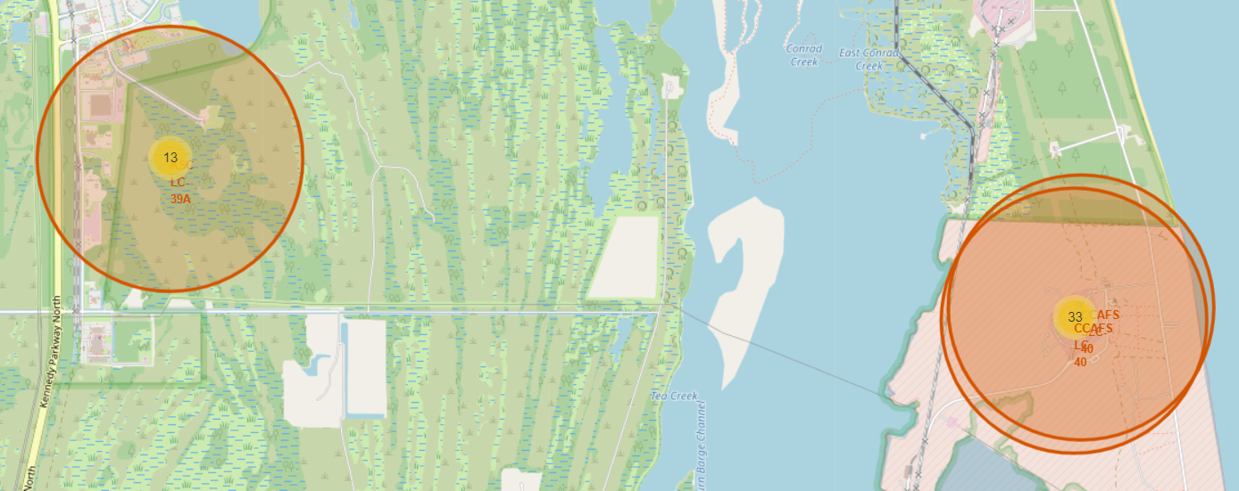
Folium: Launch Site Flight Outcome
We can easily visualize the total number of launches as well as the number of successes and failures from the interactive map

Slide 37
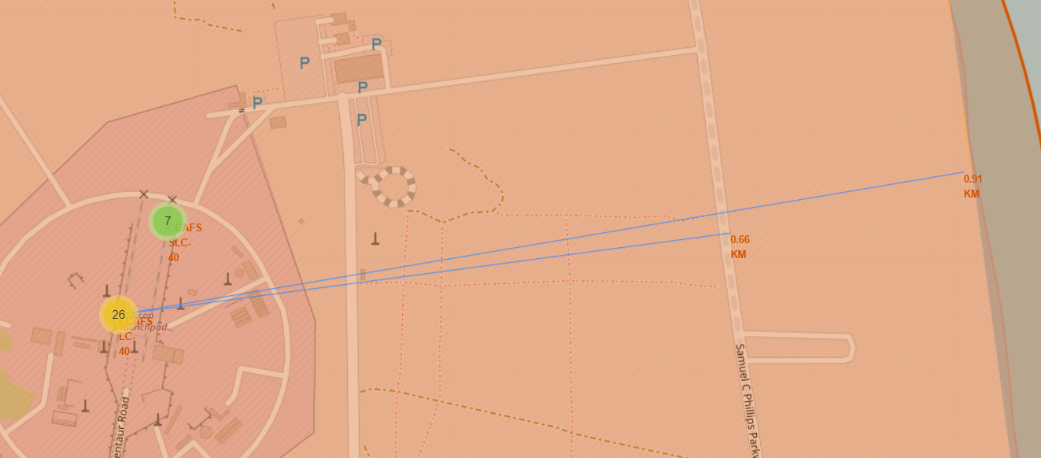
Folium: Launch Site Proximity
Here we can see that launch sites are located very close to the coastline (likely in the case of mission failure) and close to major transportation routes for ease of accessing materials

Slide 38

Section 4

Slide 39
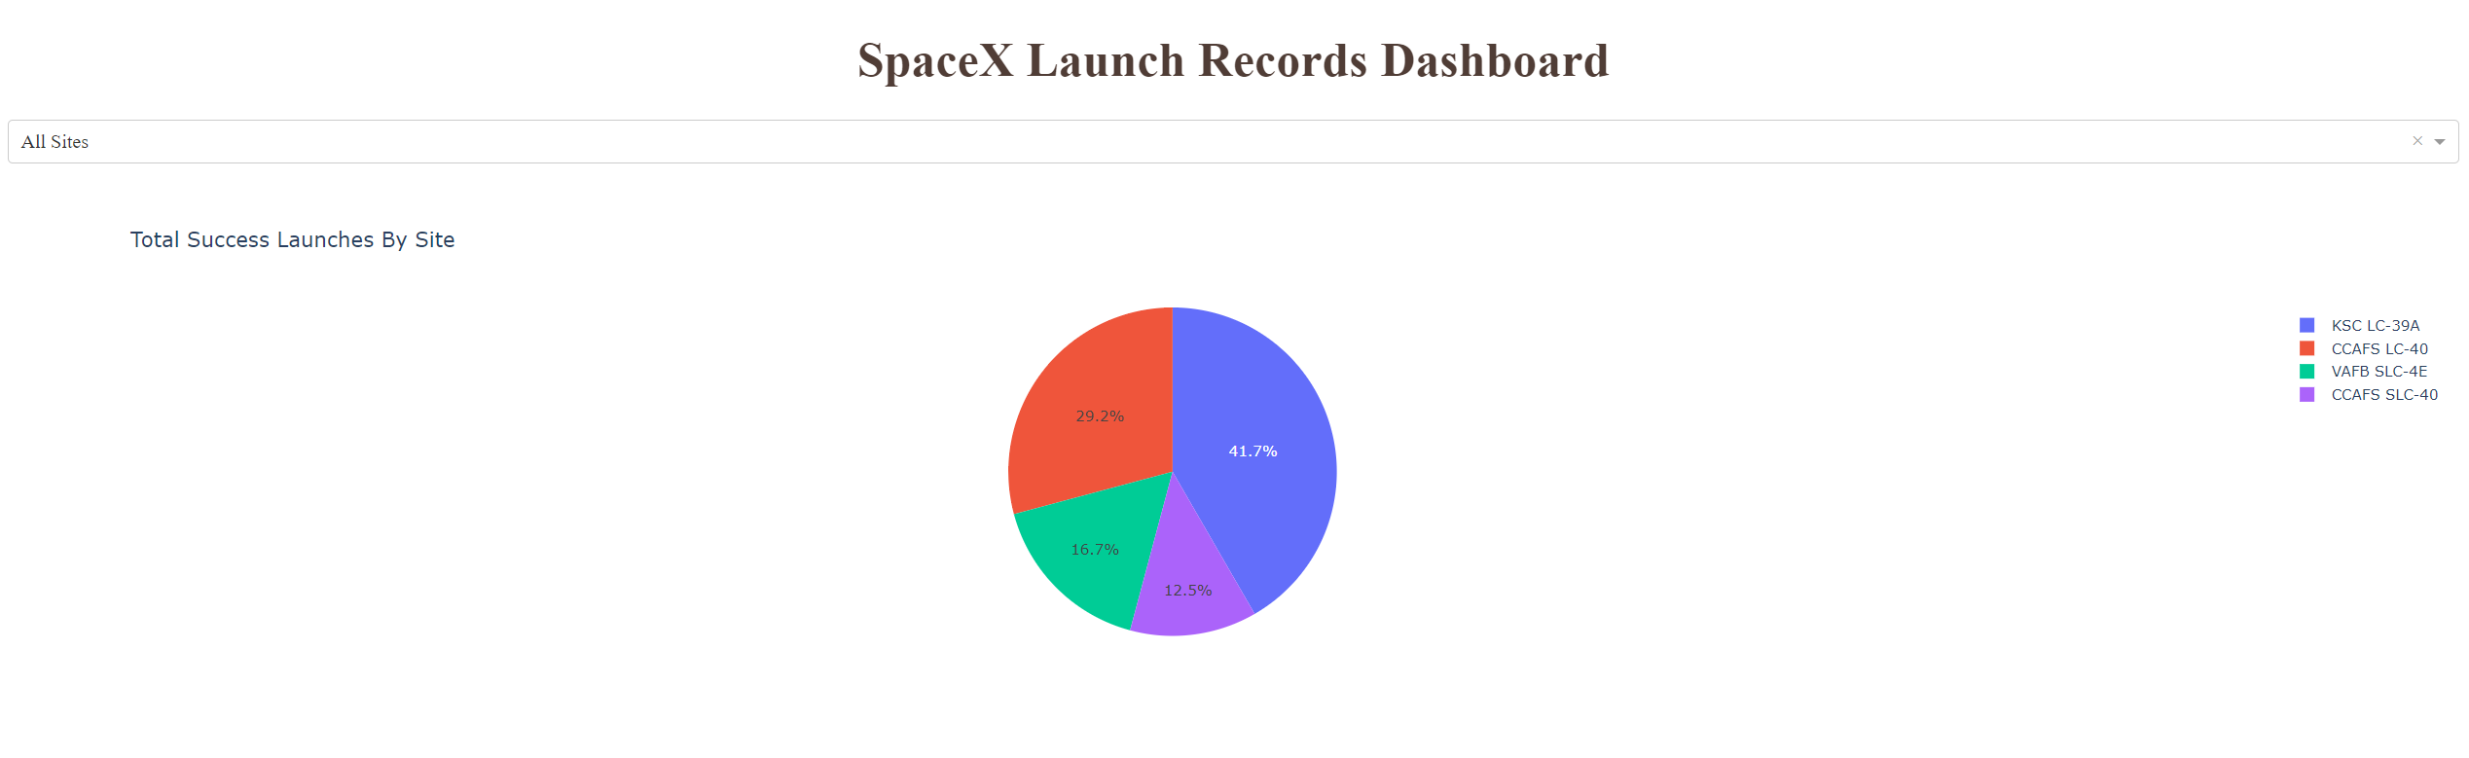
Plotly Dash: Total Success Launches
Here we can easily see that the KSC LC-39A sites has the highest number of successful flights amongst all sites

Slide 40
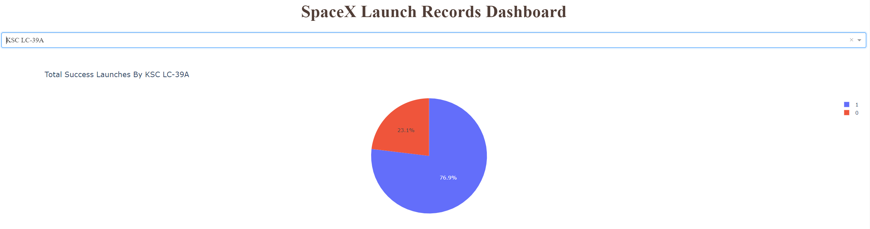
Plotly Dash: Total Success Launches by KSC LC-39A
Specifically, the KSC LC-39A has a 77% success rate

Slide 41
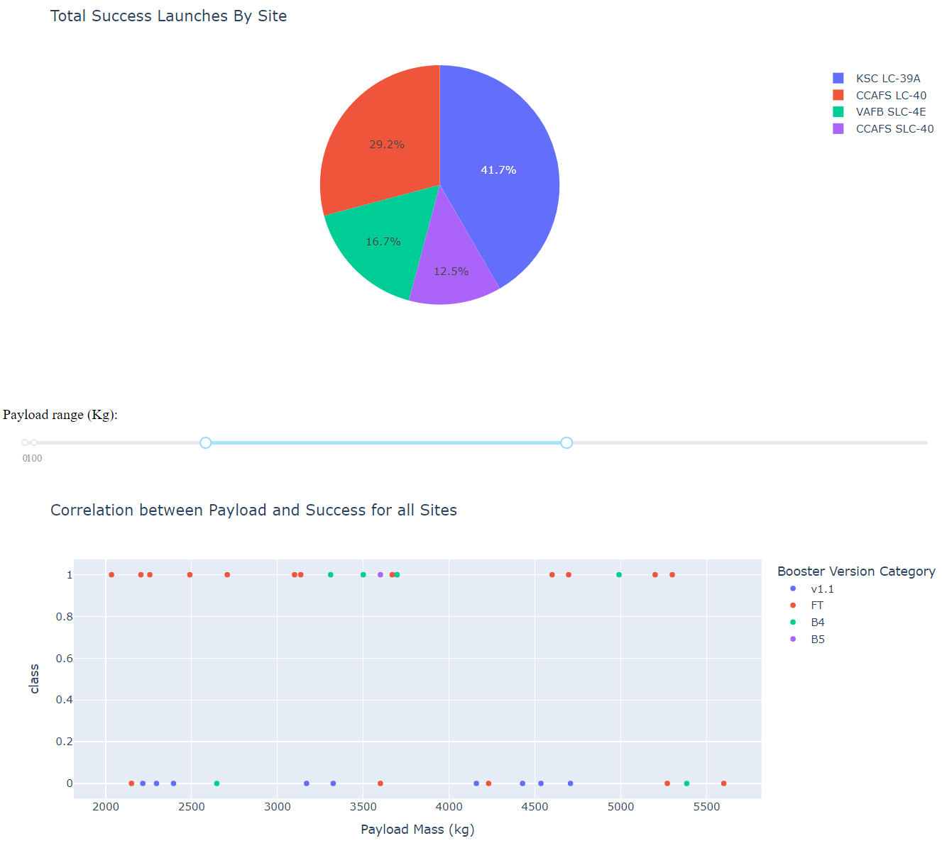
Plotly Dash: Launch Success vs. Payload Mass
We can see that many factors play a role in whether or not a launch is successful, including the payload mass as well as the type of booster

Slide 42

Section 5

Slide 43
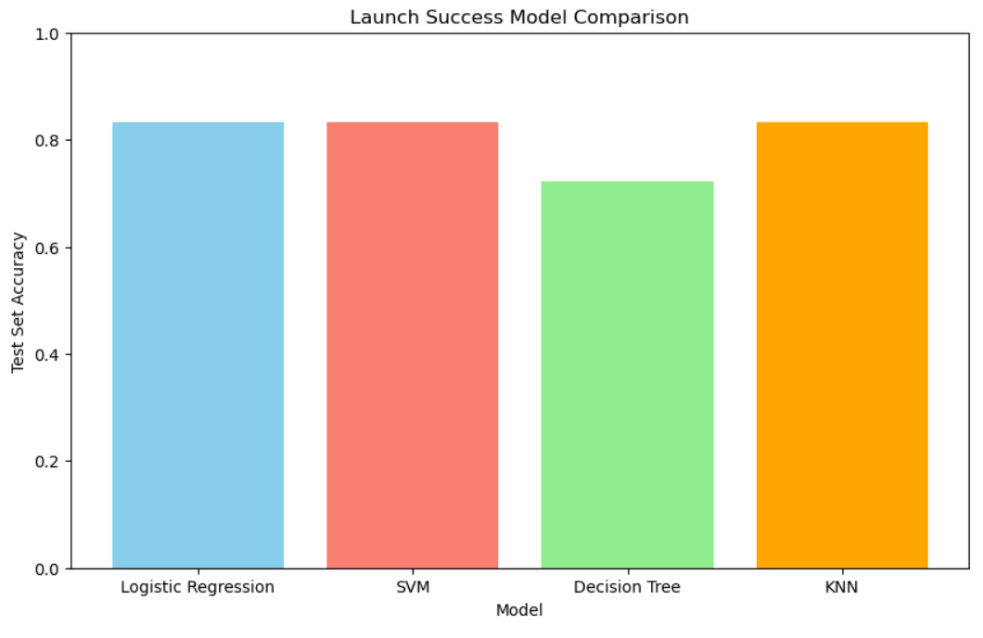
Classification Accuracy
Based on the test set results, logistic regression, SVM, and KNN all perform the best (83% accuracy) while the decision tree classifier performed the worst (72% accuracy)

Slide 44
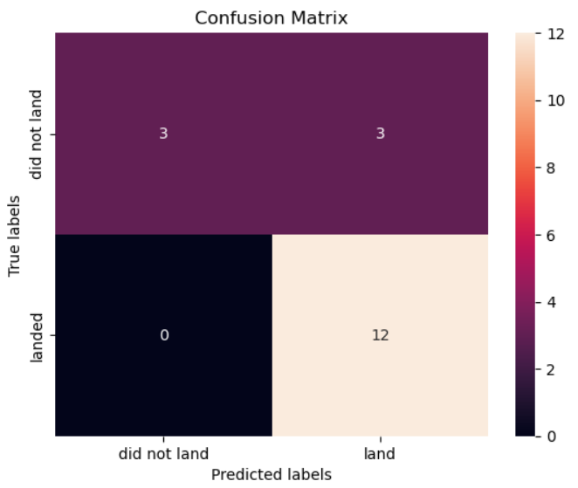
Confusion Matrix (KNN)
For the KNN model, 15 test points were correctly predicted as successes or failures
However, there were 3 false positives where the model predicted a success but the rocket did not actually land

Slide 45
Conclusions
In conclusion, a number of factors (such as payload mass and booster version, launch site) determine whether or not a landing will be a success or failure
By using a database of past launch information, we created a model that can predict whether or not a launch will be a success up to 83% accuracy

Slide 46
Appendix
Project GitHub URL

Slide 47


